Slide 1
Business Essentials
Ebert, Griffin, Starke, Dracopoulos
8th Canadian Edition

Slide 2
CHAPTER 1
Understanding the Canadian Business System

Slide 3

Learning Objectives
Define the nature of Canadian business and identify its main goals.
Describe different types of global economic systems, according to the means by which they control the factors of production through input and output markets.
Describe the interactions between business and government in Canada.
Show how demand and supply affect resource distribution in Canada.
Identify the elements of private enterprise and explain the various degrees of competition in the Canadian system.
Notes:
These learning objectives are based upon those at the beginning of the chapter. For a review of learning objectives, see the summary at the end of the chapter, as well as the list of key terms.

Slide 4

The Idea of Business and Profit
(LO 1-1)
Businesses produce or sell products in order to make a profit
Profit
Revenues
Expenses
Non-profit Organizations
  provide goods and services but do not seek profit
    schools, hospitals
Notes:
Learning Objective: 1-1
Page: 6
Notes
The text focuses on businesses only, since they generate profits. However, this discussion can be expanded to include other organizations that are active in our society which are not profit-based:
- charitable organizations
- government enterprises
The difference is that the profit motive is not present, so volunteerism is an important part of the organization’s composition.
Activity
Have students research a corporation in the library using the corporate reports. Have the students work in groups to identify the products/services sold, and the profitability of the firm in return for risking its assets to produce the goods.

Slide 5
Economic Systems Around the World
(LO 1-2)
Human Resources (Labour)
Entrepreneurs
Capital
The Factors of Production
Resources used by firms to create goods and services
Natural Resources
Information Resources
Notes:
Learning Objective: 1-2
Page(s): 6-7
Notes
The Factors of Production are basic resources which are the building blocks of an economic system, include:
natural resources: minerals, lumber, water, land
labour: human production, expertise
capital: money needed to run a business which comes from investment, borrowing or sales
entrepreneurs: the people who organize and manage the factors of production in a business environment in order to produce a profit, risking failure and loss
information: (now often included) – specialized knowledge, economic data

Slide 6
Economic Systems Around the World
(LO 1-2)
Market Economies
Command Economies
Capitalism
Mixed Economy
Socialism
Communism
Notes:
Learning Objective: 1-2
Page(s): 8-10

Slide 7

Economic Systems Around the World
(LO 1-2)
Command Economies
Communism
  government owns and operates all industries
  it makes resource distribution decisions
Socialism
  government owns and operates critical industries (utilities and major institutions)
  Individuals own non-critical businesses
Notes:
Learning Objective: 1-2
Page(s): 8

Slide 8
Economic Systems Around the World
(LO 1-2)
Market Economies
  Economic basis is supply and demand
  Political basis is capitalism
  Ownership of the factors of production is open
  Buyers and sellers have freedom of choice
  The market is the mechanism for the exchange of goods and services
Notes:
Learning Objective: 1-2
Page(s): 8
Notes
In a market economy:
Demand is willingness of consumers to buy a product or service
Supply is the willingness and ability of producers to sell the product or service
The issue of supply and demand is further discussed in additional slides for this chapter, and in the discussion of supply, demand, and price determination in the text.
The issue of choice, ability and interest are all freedoms which students identify with. They tend to approach this from a very strong cultural bias. Through discussion construct a table on the board illustrating the strengths of living in a planned, vs. a market, economy. Force them to list strengths and weaknesses of both systems.

Slide 9
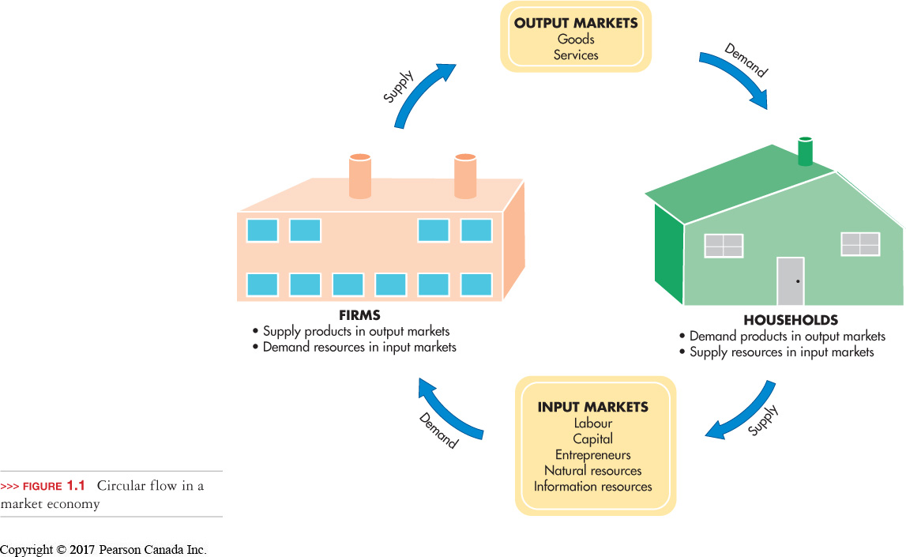
Economic Systems Around the World
(LO 1-2)
Input market
  firms buy resources from households
Output market
  households buy goods and services from firms
Notes:
Learning Objective: 1-2
Page(s): 9
Figure 1.1
Activities
Have students list the types of products that apply to input and output markets.

Slide 10

Economic Systems Around the World
(LO 1-2)
Capitalism
  Encourages entrepreneurship and the private ownership of the factors of production
  Encourages profit making as an incentive
  Operates under the concept of supply and demand
Notes:
Learning Objective: 1-2
Page(s): 7-8

Slide 11
Economic Systems Around the World
(LO 1-2)
Mixed Market Economies
  combination of both command and market economies
  no country has a pure communist, socialist, or capitalist system
  Privatization
    converting government firms into privately owned companies
  Nationalization
    the conversion of private firms into government-owned firms
  Deregulation
    reducing laws and government intervention
Notes:
Learning Objective: 1-2
Page(s): 9-10
Notes
China is encouraging entrepreneurial activity
Russia has returned to a non-communist regime
In Canada, many “necessities” or “essential services” are supplied by the state
Activities
Have students analyze the Canadian government system. This is a mixed economy. Let them indicate which aspects of the economic system are controlled by government.
Expand on the first activity by having students compare Canada’s level of government regulation with that of the United States. Then, let them describe which system is more socialistic, capitalistic, etc.

Slide 12
Interactions Between Business and Government (LO 1-3)
Customer
Competitor
Regulator
Taxation Agent
Provider of Incentives
Provider of Essential Services
Notes:
Learning Objective: 1-3
Page(s): 10-13
Notes
Government Competes: the government often sells the same products or services which private business does. Crown corporations are an example Economic Administration: the government uses various administrative methods to rule as required, including: boards, tribunals, commissions. Other regulatory agencies include organizations such as the CRTC.
Government Regulation: the government regulates many industries (transportation, banking, etc.) although the emphasis today is towards deregulation. Key areas of regulation include protecting competition, consumer protection, meeting social/safety goals, and the environment.
Taxation: the government collects tax revenue from various sources (income, restricted products (tobacco, alcohol).
Providing Incentives: government provides funding and other specialized programs to encourage business development, employment and other agenda items (e.g.: Industrial and Regional Development Program).
Providing of Services to Businesses: government assists business through trade commissions worldwide, Stats Canada reports, maps, export development.
Buying from Business: the government is a leading customer of an infinite array of goods and services purchased from the private sector.
Providing Essential Services: the government maintains the infrastructure required to maintain the market system including highways, buildings, school, hospitals, and other essential services.

Slide 13

Interactions Between Business and Government (LO 1-3)
Government as Regulator
Regulates through administrative boards, tribunals, and commissions
Promotes healthy competition between businesses
Protects consumers
Achieves social goals
Protects the environment
Notes:
Learning Objective: 1-3
Page(s): 10-11

Slide 14


Interactions Between Business and Government (LO 1-3)
Government as Taxation Agent
Revenue Tax
Progressive Revenue Tax
Regressive Revenue Tax
Restrictive Tax
Notes:
Learning Objective: 1-3
Page(s): 12
Notes
Income tax is the primary tax in effect in Canada. A tax is progressive if those with higher incomes pay a higher percent of their income on taxes. Generally, income taxes are designed to be a progressive tax.
A tax is regressive if those with lower incomes pay a higher percent of their income in taxes. Sales taxes have the effect of a regressive tax. This occurs because those with lower incomes spend a higher percent of their incomes in stores than do their richer counterparts. This means that they pay a higher percent of their income in sales taxes than do those with more money.
Activity
Statistics Canada produces a wealth of census data which reflect the spending patterns of Canadian. Have students investigate the Stats Can tables to demonstrate statistically:
1) the progressive nature of the income tax system
2) the regressive nature of sales taxes
Have students then use the tables to argue whether or not liquor and tobacco taxes are regressive or progressive in nature.

Slide 15


Interactions Between Business and Government (LO 1-3)
Government as Provider of Incentives
  Provides Aid and Financial Assistance
  Provides Incentives to stimulate growth (revenues and employment)
Notes:
Learning Objective: 1-3
Page(s): 12
Notes
Government assists business and influences its growth by offering various assistance programs or “incentives.” Such incentive may include offering financial help, training and/or information to assist a firm to export Canadian goods. These programs are often geared to specific low growth regions across the country.
Examples:
Export Development Corporation
Energy, Mines and Resources Canada
Industrial Regional Development Program
Industrial Assistance Programs
Atlantic Canada Opportunities Agency (ACOA)
Activities
Proponents of assistance programs argue that it brings hope of prosperity to under developed economic regions. Opponents of such programs insist that it creates a “grant mentality” that if you can get the money you can do it. That many businesses spawned with such programs are weak and non-competitive and unable to make it on their own. Let students debate this issue.

Slide 16








Interactions Between Business and Government (LO 1-3)
Government as Provider of Essential Services
  all three levels of government provide various services:
Notes:
Learning Objective: 1-3
Page(s): 12
Activities
Some people believe that some essential services should be privatized. The argument is that privatizing such services would increase service levels and decrease costs, thereby making them more efficient. The government has been moving to streamline such services as health care and education, but they have stopped short of actually privatizing them. Have students discuss the pros and cons of privatizing the services listed on the slide and in the text.

Slide 17
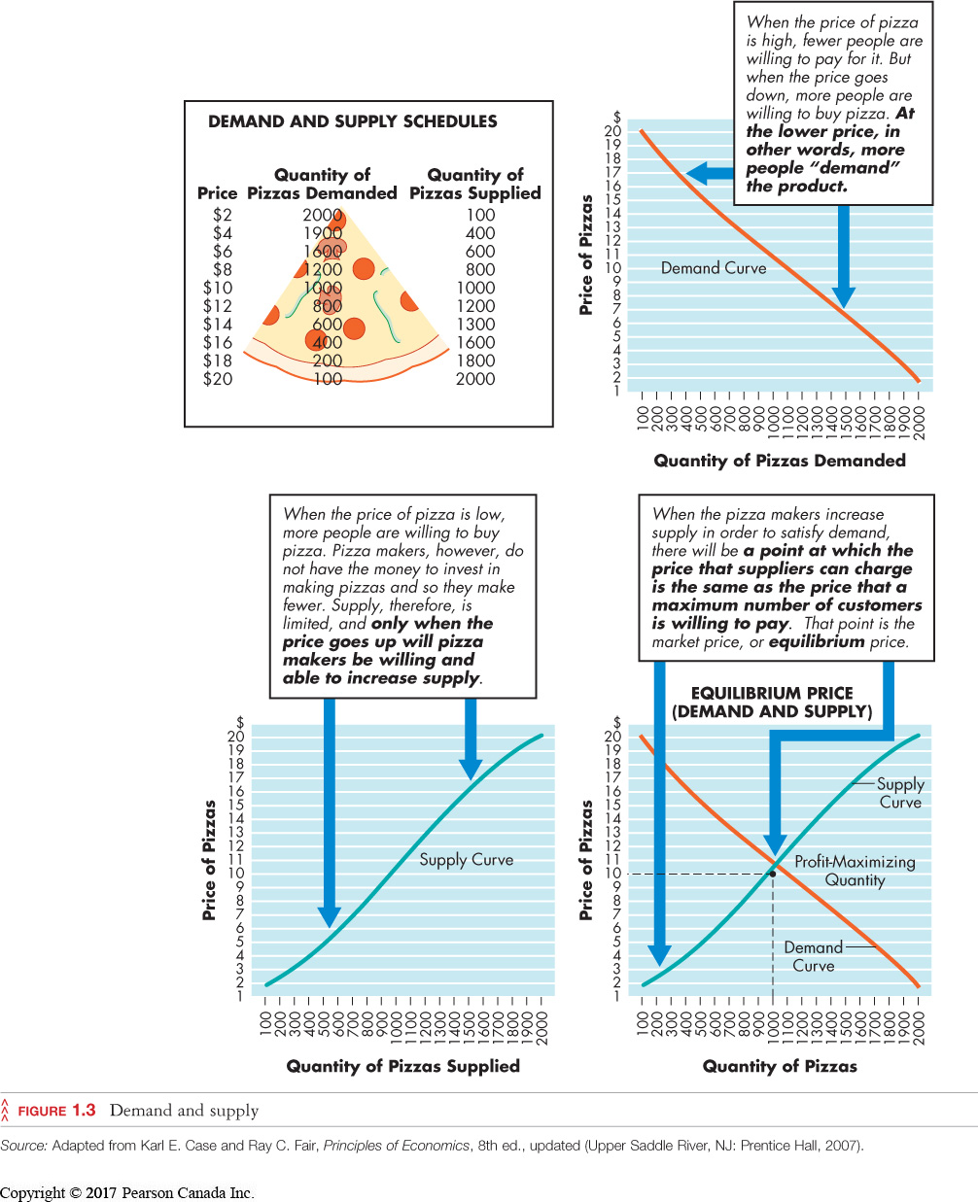

The Canadian Market Economy
(LO 1-4)
Notes:
Learning Objective: 1-4
Page(s): 13-14
Figure 1.3
Notes
Law of Demand: Consumers want to buy items at lower prices.
Law of Supply: Sellers want to sell prices at higher prices.
Equilibrium Price: Occurs when buyers are willing to purchase goods and services, of acceptable value and quality, for a price that sellers are willing to meet which allows profitability (where demand and supply curves cross).
Market research reveals how consumers feel about products and prices.
A Demand and Supply Schedule maps relationships between sellers and buyers by indicating how many units buyers will buy at various prices charged by suppliers.
Demand curves show how many units will be purchased at different price levels.
Supply curves show how many units will be produced for sale at different supply levels.
Due to the Law of Demand, the Demand curve shows more units are purchased at lower price levels.
This means the Demand Curve slopes downward to the right (as prices go up the amount purchased decreases).
Due to the Law of Supply, the Supply curve shows more units are produced for sale at higher price levels.
This means that the Supply Curve slopes upward to the right (as prices go up the amount produced increases).
Where the Supply and Demand Curves meet shows the “equilibrium price.”
The equilibrium price is the price at which buyers will purchase and suppliers will produce the product.
The market price emerges naturally as part of the exchange process in a market economy.

Slide 18
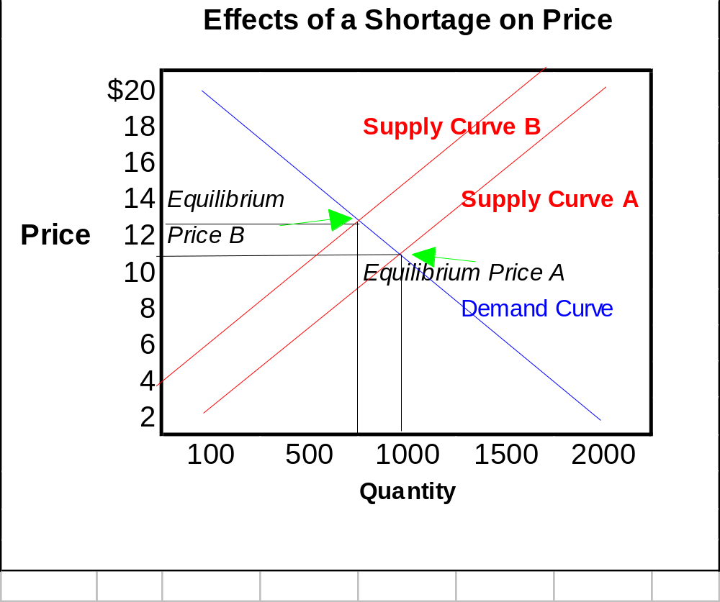
Supply and Demand
(LO 1-3)
Dealing with a Shortage
A shortage drives
prices up
Notes:
Learning Objective: 1-4
Page(s): 14
Notes
Shortage: a lack of supply
Limited supply will shift the Supply Curve sideways to the left.
This will create a new equilibrium price crossing the Demand Curve at a higher price point than normal.
This shows that shortages drive prices up.
Individual suppliers will lose potential revenue from selling more units even at lower prices.
The lack of supply can anger consumers and destroy their confidence in the market and its suppliers.
Suppliers attempt to produce the number demanded to avoid shortages or surpluses which are ultimately damaging and reduce profits.

Slide 19
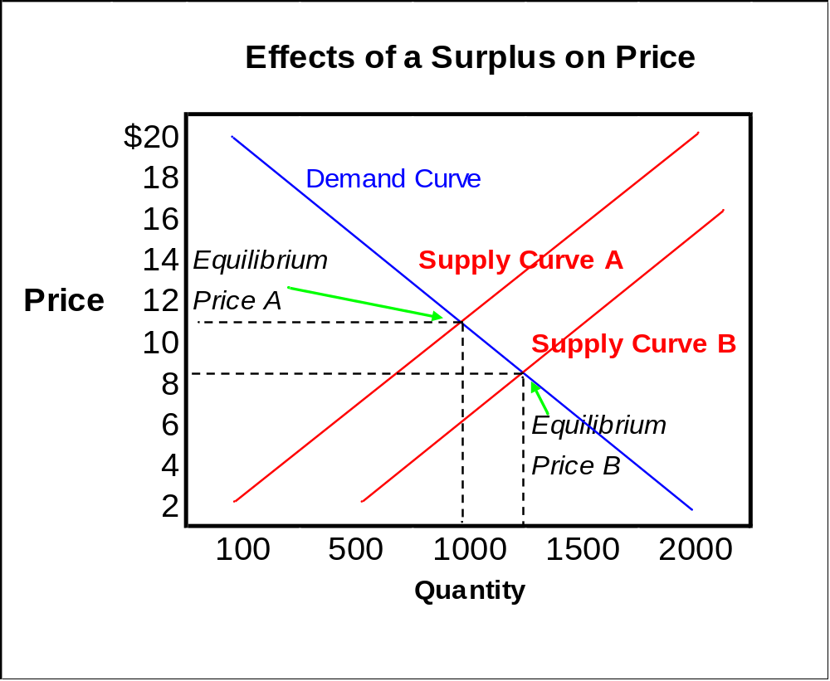
Supply and Demand
(LO 1-3)
Dealing with a Surplus
A surplus drives prices down
Notes:
Learning Objective: 1-4
Page(s): 14
Notes
Surplus: an abundance of supply
Extra supply will force the Supply Curve to shift sideways to the right.
This will create a new equilibrium price crossing the Demand Curve at a price point which is lower than normal.
This shows that surpluses drive prices down.
Individual suppliers will have waste and lose profits.

Slide 20
Private Enterprise and Competition
(LO 1-5)
Private enterprise occurs in a market economy with little government restriction
Under this system individuals
  can own property
  have freedom of choice
  have the freedom to earn profits
  have freedom to compete
Notes:
Learning Objective: 1-5
Page(s): 14-16
Activity
Class Discussion: Private property is a basic right that most of us take for granted. Give examples of how some people in non-capitalist nations do not have our right to private property. How would students respond if their rights were suddenly gone? How much of their future career prospects revolve around the freedom to acquire and control their own property? Does one’s property define who and what they are in our consumer-oriented society?

Slide 21


Private Enterprise and Competition
(LO 1-5)
Competition
  occurs when businesses vie for the same resources or customers in a particular market or industry.
    motivates business to operate efficiently
    forces business to make products better or cheaper
Notes:
Learning Objective: 1-5
Page(s): 14-16

Slide 22
Private Enterprise and Competition
(LO 1-5)
Degrees of Competition
Perfect Competition
Monopolistic Competition
Oligopoly
Monopoly
Notes:
Learning Objective: 1-5
Page(s): 14-16
Notes
The degrees of competition are influenced by:
The number of firms competing for the same consumer’s dollar
The similarity of their products or services in the eyes of consumers
This influences the firms by:
Giving them more, or less, control over price depending on various factors
Making it more difficult to compete, or not, depending on various factors

Slide 23
Private Enterprise and Competition
(LO 1-5)
Perfect Competition
  many sellers; product is basically identical
  relatively easy to enter the industry
  individual firms have no control over price
Notes:
Learning Objective: 1-5
Page(s): 14-16

Slide 24

Private Enterprise and Competition
(LO 1-5)
Monopolistic Competition
  few to many sellers; product is seen as unique by some buyers (not all)
  differentiated brands have some (minor) control over pricing
Notes:
Learning Objective: 1-5
Page(s): 14-16

Slide 25
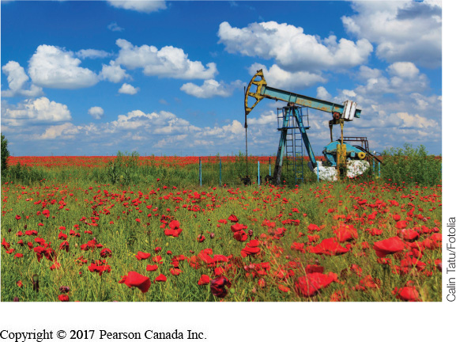
Private Enterprise and Competition
(LO 1-5)
Oligopoly
  a few large suppliers dominate
  high barriers to entry
  products are seen as similar
  prices gravitate toward a common
  “market price”
Monopoly
  one producer and source of supply
  unique product
  complete control over price
  no competitors
Notes:
Learning Objective: 1-5
Page(s): 14-16
Notes
Oligopolies are confusing because some have more than a few contenders. The operational issue in these cases is that the few are large enough to dominate the market.
If one raises his/her price, they will lose sales to the others
If one lowers his/her price, the others will lower prices to compete and everyone earns less money
Examples typically include:
Automobiles
Retail gasoline dealers
Sugar producers

Slide 26
QUICK-CHECK QUESTIONS
1) The most important difference between command economies and market economies is______.
A) access to human rights
B) who controls the factors of production
C) the government in power
D) freedom of the press
Answer:
B) who controls the factors of production

Slide 27
QUICK-CHECK QUESTIONS
2) When Henry Ford adopted the assembly line to mass produce the Model-T in 1913, he decided to pay his workers a relatively high wage because he believed that workers should be able to afford to buy what they make. This is consistent with the idea of _______________.
A) communism
B) input and output markets
C) socialism
D) privatization
Answer:
B) input and output markets

Slide 28
QUICK-CHECK QUESTIONS
3) The political basis for the free market economy is called ____________ which allows private ownership of the factors of production and encourages entrepreneurship by offering profits as an incentive.
A) Marxism
    B) Capitalism
    C) Consumerism
    D) Socialism
Answer:
B) Capitalism

Slide 29
QUICK-CHECK QUESTIONS
4) If U2 is playing to a sold-out concert this Friday night but tickets are still in high demand, concert-goers are likely to buy tickets from ‘scalpers’ at prices considerably higher than the original price. This situation can be described as a:
A) shortage; in which quantity demanded exceeds quantity supplied.
B) surplus; in which quantity demanded exceeds quantity supplied.
C) shortage; in which quantity supplied exceeds quantity demanded.
D) surplus; in which quantity supplied exceeds quantity demanded.
Answer:
A) shortage; in which quantity demanded exceeds quantity supplied.

Slide 30
QUICK-CHECK QUESTIONS
5) The markets for laundry detergents, soft drinks and cars are all dominated by just a few producers. In terms of competition these markets are described by the term:
    A) perfect competition
    B) monopoly
    C) oligopoly
    D) pure competition
Answer:
C) Oligopoly

